Slide 1
Modeling and Evaluation of Energy Consumption of Congestion Control Algorithms in Wireless Sensor Networks
Student's Name: Saad Al-Ghuaribawi
Supervisor: Dr. Abdollahi Azgomi

Slide 2
Road Map
The routing approach based on energy consumption in a sensor network is very important, because the main goal is to explain how the consumption is distributed in the network.
In such a case, due to the use of various topologies and prioritization of evaluation over other features, the design and implementation of modeling is very important in solving the existing challenges.
The purpose of choosing different clustering mechanisms among different classes is to be able to choose the appropriate clustering algorithm based on the characteristics of the network. Many methods have been proposed to implement security and thus increase the productivity of wireless sensor networks.

Slide 3
Road Map (cont.)
This systematic roadmap describes known attacks against all layers and specifically analyzes and defines undermining attacks against routing protocols.
The routing protocol also includes some proposed countermeasures against attacks, design considerations, and a paper contribution. The assertion of this study is that WSN routing protocols must be written with protection in mind, and this is the only efficient solution for achieving secure routing over WSNs.
The purpose of this whitepaper is also to present issues, attacks, and countermeasures related to protection. Finally, we hope that this roadmap will inspire potential researchers to develop smarter, better protections and make networks more secure.

Slide 4
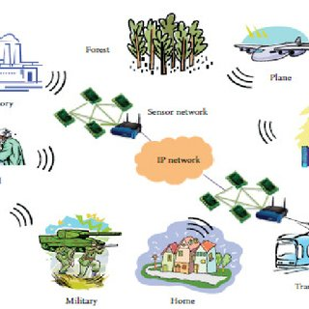
Introduction
In recent years, wireless sensor network have attracted the attention of both in academia universities and industry due to its wide range of potential applications in military and civilian fields.
In the organization of a wireless sensor network, sensor nodes are used. Since the task of sensor nodes is to sense and collect data and transfer them to the information center, sensor nodes are originally a set of nodes that have the desired data.

Slide 5
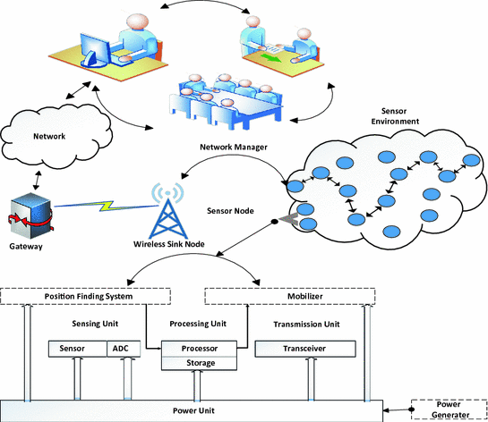
Basic concepts
Wireless Sensor Network (WSN)
Transport layer
Network layer
Data link layer
Physical layer
Features of wireless sensor network
• Consumption of power limits for nodes with power
• Ability to manage with node failure
• Some node mobility and node heterogeneity
• Scalability on a large scale of distribution
• Reliability of harsh environmental conditions
• Simple to use
• Cross layer design

Slide 6
Related works
(Bhara et al. - 2022) Recent advances in low-power communication and signal processing technologies have led to the widespread implementation of wireless sensor networks.
(Qanvati et al.-2015) One of the main challenges in healthcare wireless body network (WBAN) applications is congestion control.
(Awan-2019) A wireless body area network is a set of heterogeneous computing devices based on the Internet of Things or IoT, which is mainly used in healthcare monitoring applications.
(Chen - 2018) Wireless Body Area Networks (WBAN) is a new form of technology that provides a foundation for various wearable and implantable sensors.
(Liu et al.-2020) The commercialization of wireless body area network (WBAN) foresees new conditions in the future for synchronizing WBAN devices within a range and locally.

Slide 7
(Pandy et al.-2020) In the current era of information and communication automation, wireless networks are emerging as an emerging technology due to its obvious advantages over wired networks.
(Badruddin et al.-2020) Wireless body area networks (WBAN) are special types of wireless sensor network (WSN) research in which sensors are implanted on or outside the body to monitor, collect, process, and transmit measurements of various body parameters.
(Anwar et al.-2018) The reduction of health facilities in proportion to the population is a leading threat to the current health care systems.
(Nova et al.-2018) Electronic healthcare technology includes the use of wearable sensors to monitor the health status of the patient's biological signals, whereby new techniques miniaturize these sensors.

Slide 8
Research motivations
The battery power should be used efficiently in order to increase the lifetime of the node.
Congestion increases the packet drop rate, delays and reduces the throughput and lifetime of the node.
The research conducted in the field of wireless sensor networks has identified congestion control algorithms with optimal energy consumption as one of the energy saving mechanisms.

Slide 9
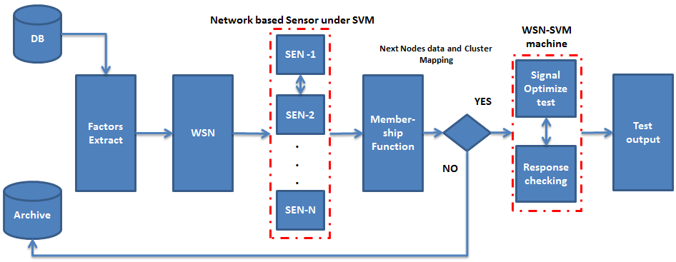
SYSTEM MODEL
Type of research in terms of method Transmission rate is one of the effective factors in the performance of wireless sensor networks. In order to get less error in the classification, the crowd control algorithm and its combination with SVM are used. In this set of modules, the evaluation parameters including precision, recall, F1 score and support are used to build the model showing the effectiveness of the model.

Slide 10
PROBLEM
In recent years, wireless sensor network have attracted the attention of both in academia universities and industry due to its wide range of potential applications in military and civilian fields. In such applications, the sensor nodes sense the data of these areas and may manipulate them and transmit to the final destination, that is, the sink node.
This leads to the draining of battery energy, which in turn causes the node to fail. In this research, we review and compare the existing congestion control algorithms in wireless sensor networks.
We also model the network with respect to energy consumption, measurement and event extraction analysis in the network.

Slide 11
Conclusion
In order to improve the energy efficiency and address the limitation problem in WSN networks, we propose an energy efficient routing protocol based on congestion control algorithms called WSN-SVM.
In the system modeling process, we first formulate an energy evaluation model to determine the energy status of a node, and then create a communication range to identify the effective transmission area.
In addition, we analyze the accuracy and computational complexity of this algorithm.

Slide 12
References
[1] T. Behera, U. Samal, S. Mohapatra, M. S. Khan, B. Appasani, N. Bizon, P. Thounthong. (2022). Energy-Efficient Routing Protocols for Wireless Sensor Networks: Architectures, Strategies, and Performance, 11, 2282. https://doi.org/10.3390/electronics11152282
[2] S. Ghanavati, J. Abawajy, D. Izadi. (2015), A Congestion Control Scheme Based on Fuzzy Logic in Wireless Body Area Networks, IEEE 14th International Symposium on Network Computing and Applications
[3] K. M Awan, N. Ashraf, M. Saleem, O. Sheta, K. Qureshi, A. Zeb, K. Haseeb, A. Sadiq. (2019). A priority-based congestion-avoidance routing protocol using IoT-based heterogeneous medical sensors for energy efficiency in healthcare wireless body area networks, International Journal of Distributed Sensor Networks, 2019, Vol. 15(6), DOI: 10.1177/1550147719853980
[4] D. Chen. (2018). A real-time streaming control for quality-of-service coexisting wireless body area networks, Applied Soft Computing 68 (2018) 719–732 https://doi.org/10.1016/j.asoc.2017.08.035
[5] Q. Liu, K. Mkongwa, C. Zhang, S. Wang. (2020). A simple cross‑layer mechanism for congestion control and performance enhancement in a localized multiple wireless body area networks, Received: 21 June 2020 , https://doi.org/10.1007/s12652-020-02802-5
[6] D. Pandey, V. Kushwaha. (2020). An exploratory study of congestion control techniques in Wireless Sensor Networks, https://doi.org/10.1016/j.comcom.2020.04.032
[7] W. Badreddine , C. Chaudet , F. Petruzzi , M. Butucaru . (2020). Broadcast strategies and performance evaluation of IEEE 802.15.4 in wireless body area networks WBAN, Ad Hoc Networks 97 (2020) 102006

Slide 13
[8] M. Anwar, A.Abdullah, R. Saedudin, F. Masud, F. Ullah. (2018). CAMP: Congestion Avoidance and Mitigation Protocol for Wireless Body Area Networks, , https://doi.org/10.30880, Vol. 10 No. 6 (2018) p. 59-65.
[9] V. Navya , P. Deepalakshmi. (2018). Energy eﬃcient routing for critical physiological parameters in wireless body area networks under mobile emergency scenarios, , https://doi.org/10.1016/j.compeleceng.2018.10.011
[10] A. Ali, M. Vadivel. (2022), Energy Efficent Congestion Control Scheme Wireless sensor Network using Adaptive Neuro Fuzzy Inference System With Black Widow Optimization, https://doi.org/10.21203/rs.3.rs-1974413/v1
[11] S. Hao, Y.Hong, Y. He. (2022), An Energy-Efficient Routing Algorithm Based on Greedy Strategy for Energy Harvesting Wireless Sensor Networks, doi.org/10.3390/s22041645
[12] S. Kumar Gupta, S. Sing. (2022), Survey on energy efficient dynamic sink optimum routing for wireless sensor network and communication technologies, https://doi.org/10.1002/dac.5194

Slide 14
Q and A
At the same time, the following questions are supposed to be answered in this research:
1. Which congestion control algorithm is used in the prediction of the most suitable factors?
2. What are the most suitable types of data sets in predicting the factors and what are their characteristics?
3. How can the most appropriate modeling method be applied to the selected factors?

